Slide 1
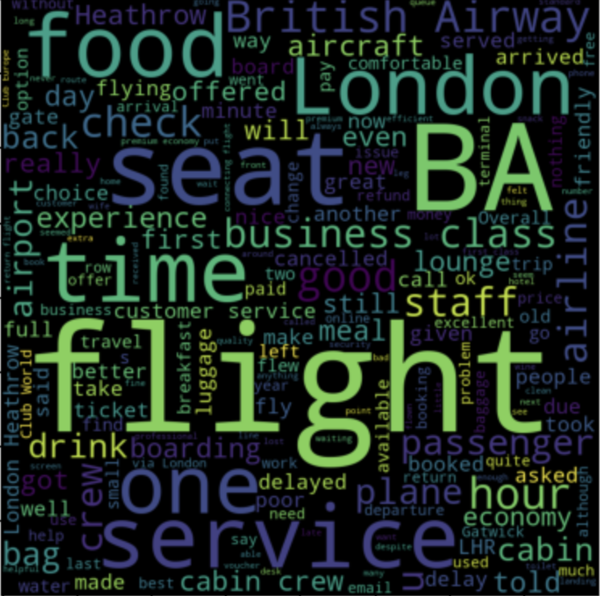
Skytrax Review Summary
Comments and ratings included in verified reviews

Slide 2
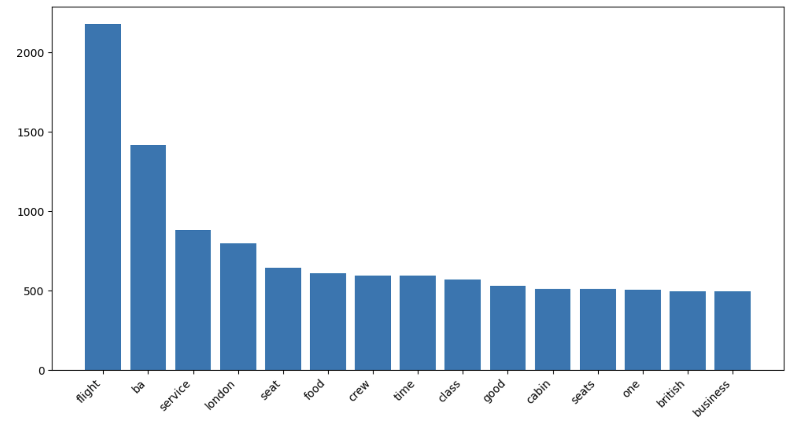
General Comments regarding experiences
Top words mentioned in reviews
Mixed reports regarding flight punctuality
Exceptional cabin crew service
Dissatisfaction with wifi, ground service
Should cater for more in-flight amenities
London Heathrow as common stop
Would passengers recommend British Airways?
Yes: 406
No: 769
General sense of dissatisfaction

